Slide 1
Age of Exploration
Part 1-
Africa and Europe
in the 1400s

Slide 2
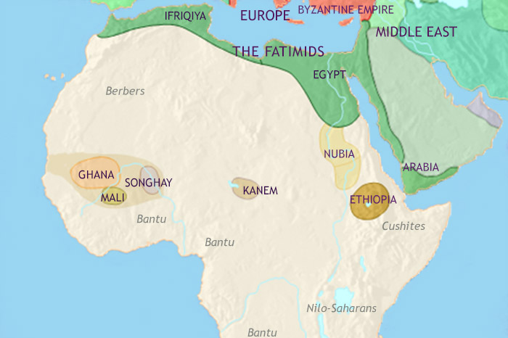
By the 1400s, people in West Africa had been thriving for hundreds of years.

Slide 3
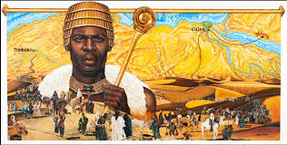
They had advanced civilizations and large, powerful empires ruled at different times.

Slide 4
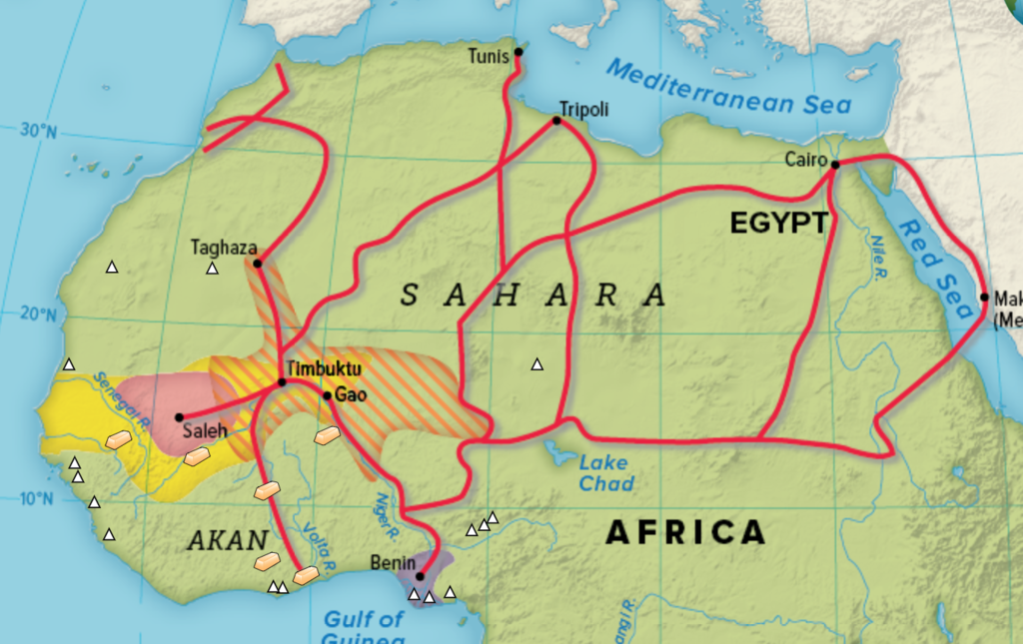
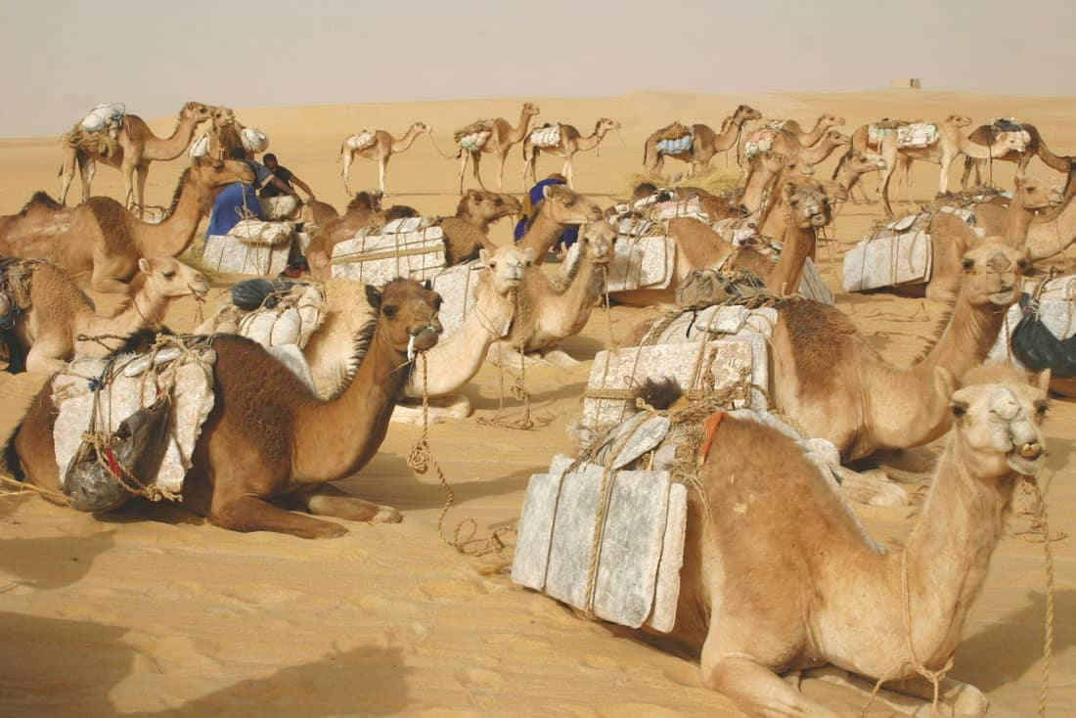
Trade was very important to these empires. West Africans traded with people in Northern Africa and Asia. The gold-salt trade became very profitable.

Slide 5
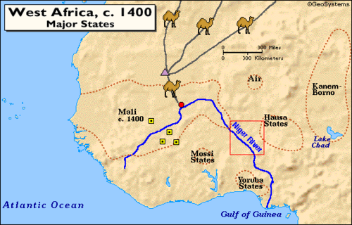
Cities like Timbuktu became important centers of trade. Timbuktu was called the “meeting point of the camel and the canoe” because of its location at the crossing point of the trans-Sahara trade routes and the Niger River.

Slide 6
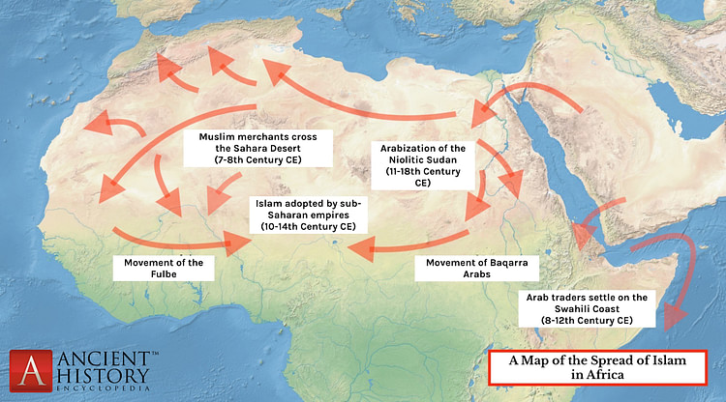
Through trade, the Muslim religion was introduced to West Africa. Sometimes people were slow to accept this new religion. Some mixed Islam with their traditional religion.

Slide 7
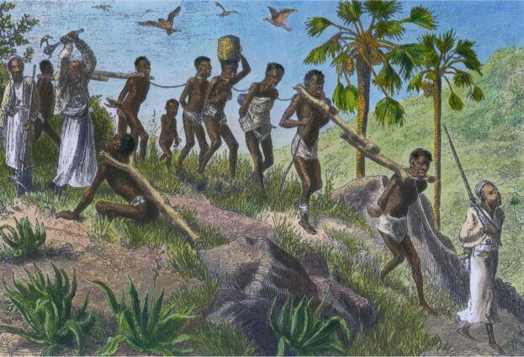
Slaves were also part of trading with other regions. These slaves were sometimes taken to lands as far as Arabia, Persia, India, and even China!

Slide 8
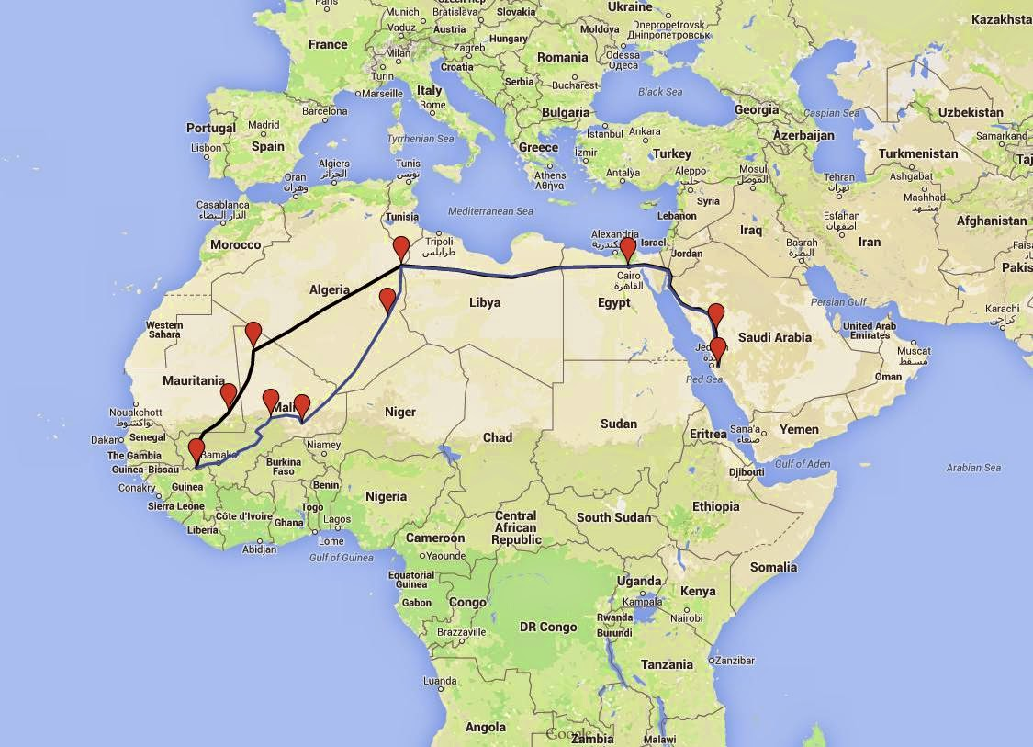
Mansa Musa Pilgrimage

Slide 9
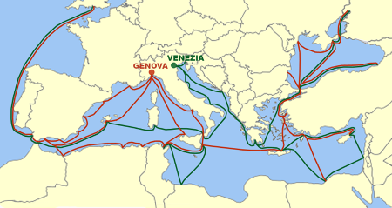
By the 1400s, Venice and Genoa (in Italy) controlled most trade in the Mediterranean region.

Slide 10
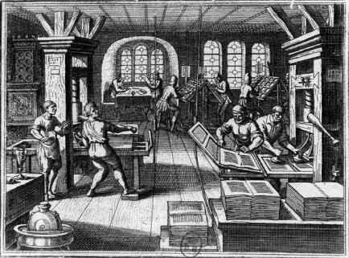
However, many people in Western Europe were beginning to become more curious about the world around them.

Slide 11
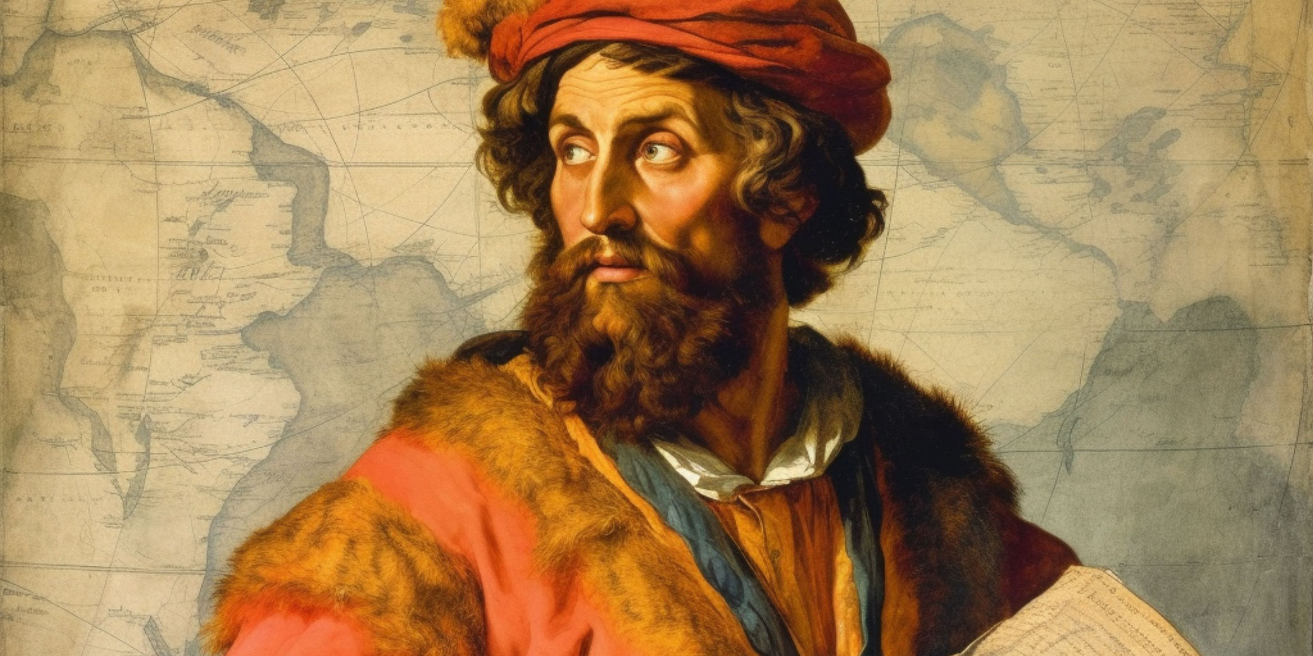
Life in Europe was becoming more prosperous, and people learned about explorers like Marco Polo and his adventures in Asia.

Slide 12
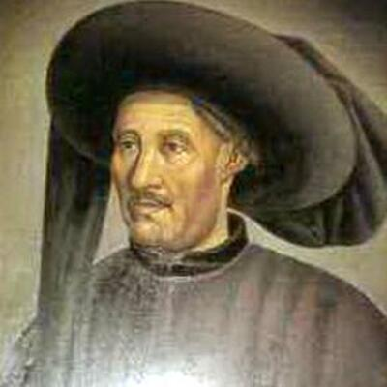
Several countries started to explore further and further from home. Portugal led the way with Prince Henry, who became known as Henry the Navigator, sponsoring many voyages.

Slide 13
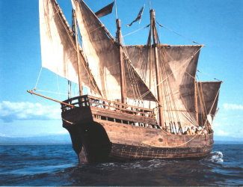
Advances in navigation and technology led the way. A new type of ship, called a caravel, was designed which made sea travel easier and safer.

Slide 14
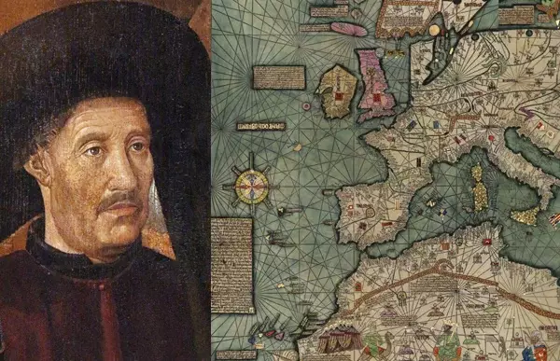
Prince Henry wanted to find an all-water route to Asia, learn more about the ocean and lands beyond it, and spread Christianity to those new lands.

Slide 15
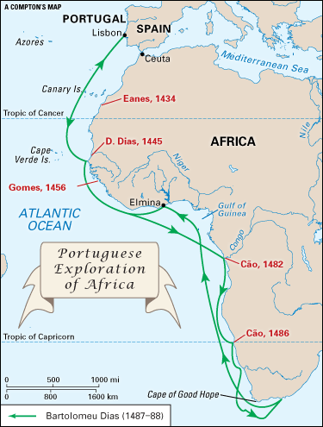
Portugal explored the West African coast and began trading with the people there. By the 1440s, the Portuguese started to trade for slaves.

Slide 16
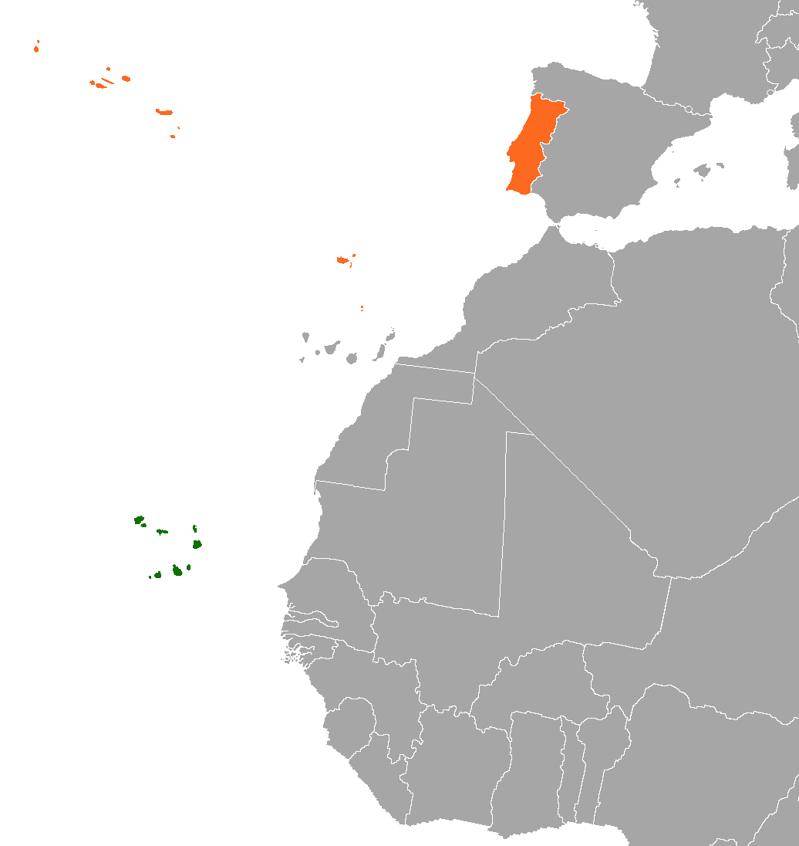
Many of these slaves were sent to the Cape Verde Islands off the West African coast where they would work on sugar cane plantations. This was the start of plantation slavery.

Slide 17
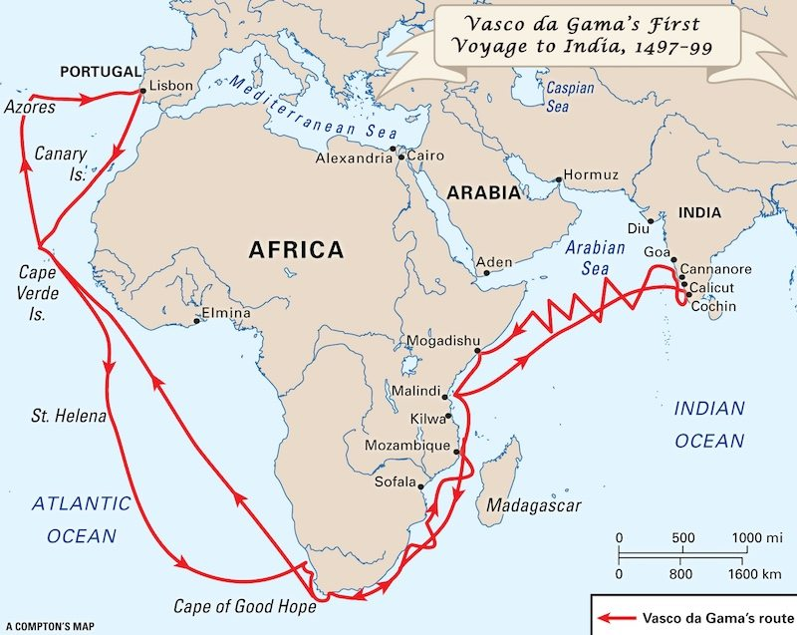
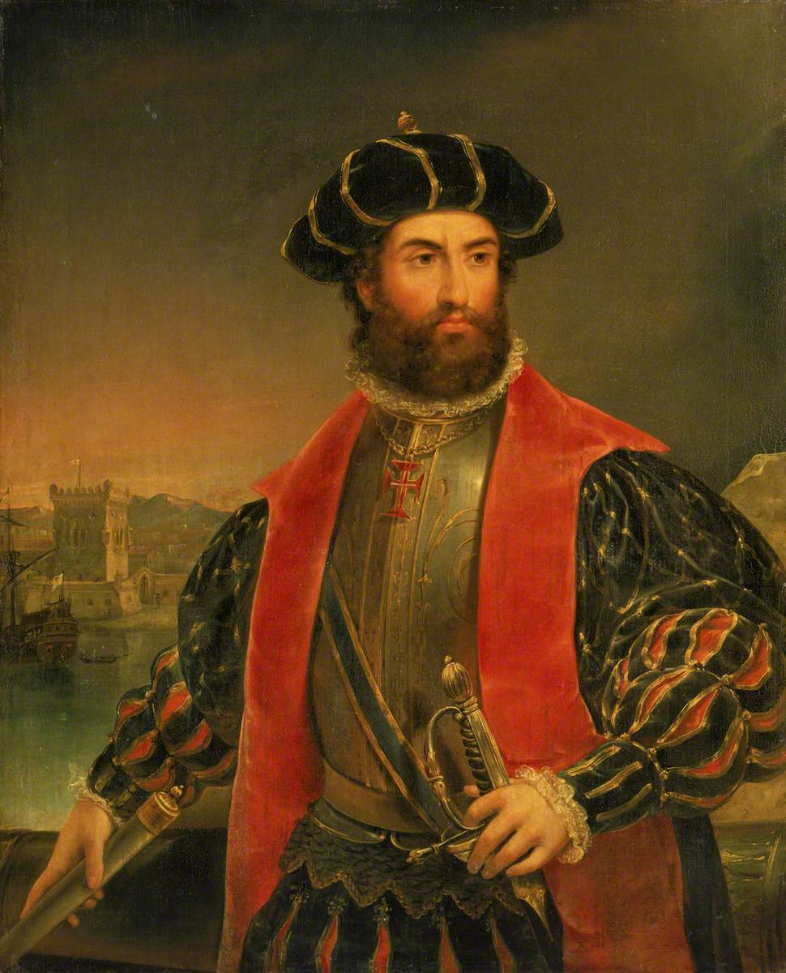
In 1497, Portuguese explorer, Vasco da Gama made his way to India. They had finally found an all-water route to Asia.

Slide 18
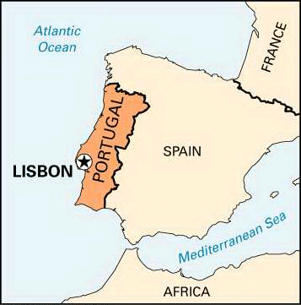
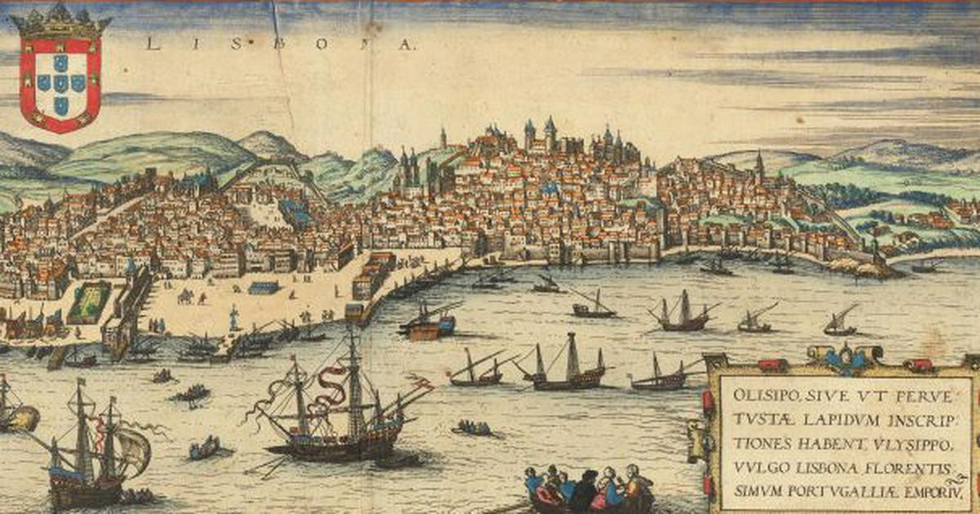
This ended Italy’s monopoly of trade with Asia and Lisbon, Portugal, became the richest port in Europe.

